Slide 1
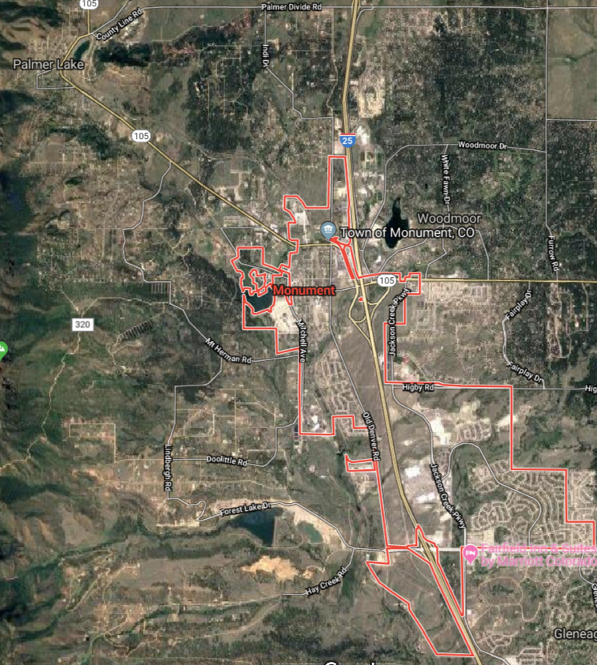
Tri-Lakes State of the Region El Paso County Update February 1, 2019
Commissioners
Stan VanderWerf
Holly Williams

Slide 2
Overview
Hails and Farewells
County Update
Discussion and Q & A

Slide 3
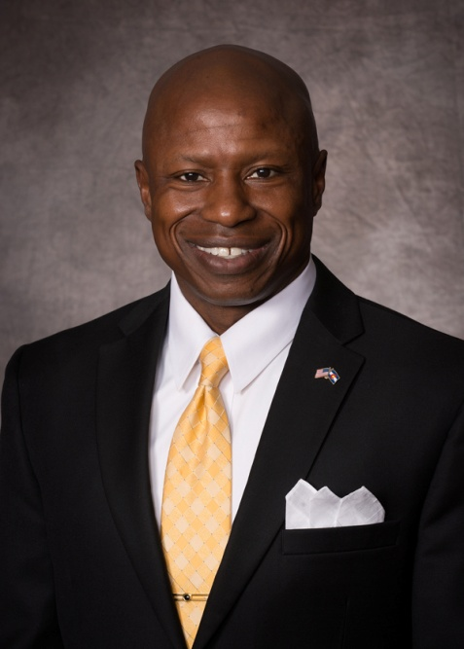
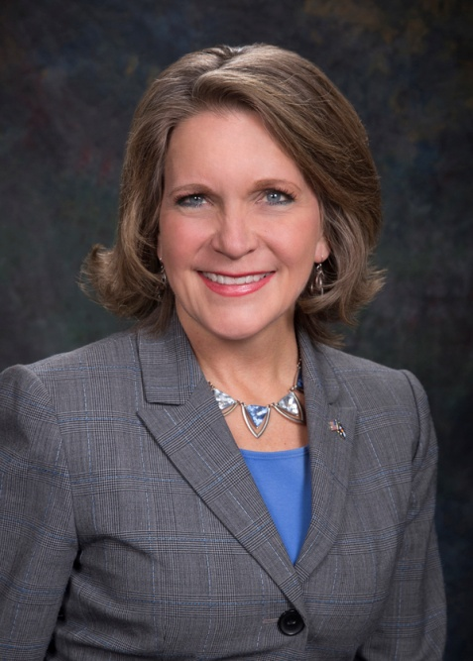
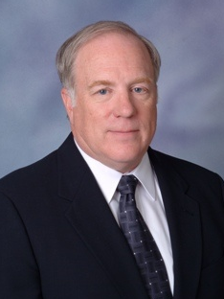
Farewells
Darryl Glenn Commissioner District 1
Peggy Littleton
Commissioner District 5
Dr. Robert Bux
Coroner

Slide 4
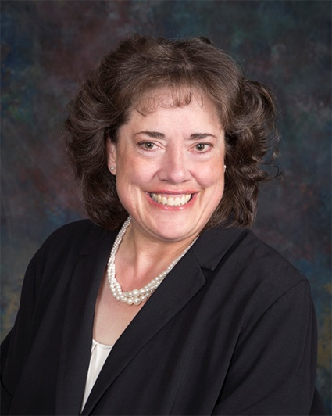
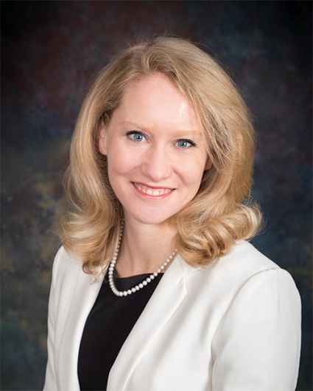
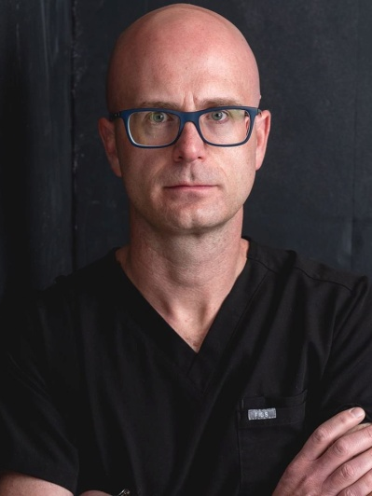
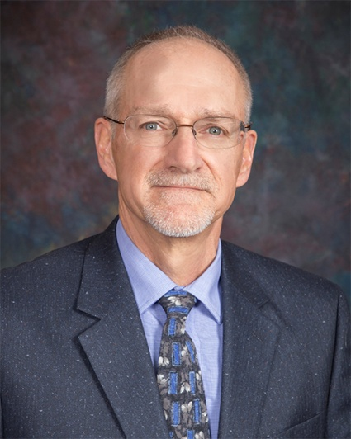
Hails
Commissioner
Holly Williams
Commissioner
Cami Bremer
Coroner
Dr. Leon Kelly
Surveyor
Richard Mariotti

Slide 5
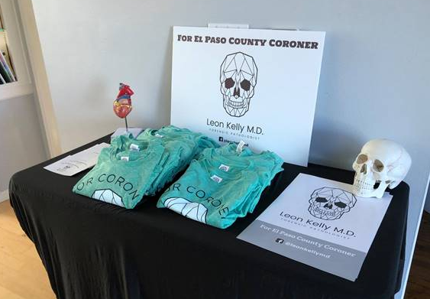
We Enjoy Our Work
Anyone with Campaign material like this
knows what they are doing!

Slide 6
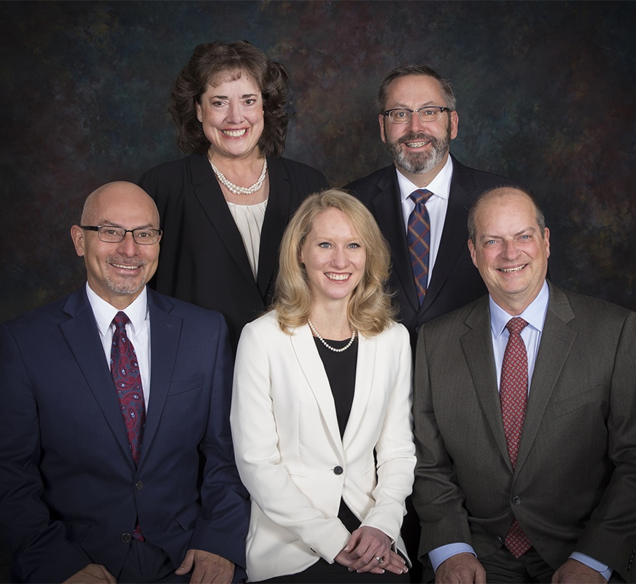
New Commissioners Up and Running
Holly Williams
District 1
Mark Waller
District 2, Chair
Stan VanderWerf
District 3
Longinos Gonzales
District 4, Vice-Chair
Cami Bremer
District 5

Slide 7
Commissioner Boards
Holly Williams, District 1 • Colorado Springs Convention & Visitors Bureau Partnership Committee • Colorado Springs Regional Joint Use Land Study: USAFA/ Peterson AFB/ Fort Carson • Pikes Peak Area Council of Governments (PPACG) • Pikes Peak Rural Water Authority • Pikes Peak Rural Transportation Authority (PPRTA) Board of Directors • El Paso County Regional Resiliency Collaborative • Colorado State University (CSU) Extension Advisory Committee • Highway Advisory Commission • Forestry & Weed Advisory Commission • City/County Drainage Board • Board of Adjustment
Stan VanderWerf, District 3
• Criminal Justice Coordinating Council • City Airport Advisory Committee • Fountain Creek Watershed, Flood Control, and Greenway District Board • Pikes Peak Area Council of Governments (PPACG) • Pikes Peak Workforce Consortium Executive Committee • Pikes Peak Small Business Development Center Advisory Board • Highway Advisory Commission • Park Advisory Board (Park Fee Advisory Committee) • El Paso County Board of Retirement • Placement Alternatives Commission • Colorado Springs Chamber & EDC Military Affairs Council

Slide 8
County Update
Challenges
And
Achievements

Slide 9
Population Growth
712,000 Residents
526,000 Incorporated
185,000 Unincorporated
Most populous County in Colorado
Projected to Reach 1.2 million by 2050

Slide 10
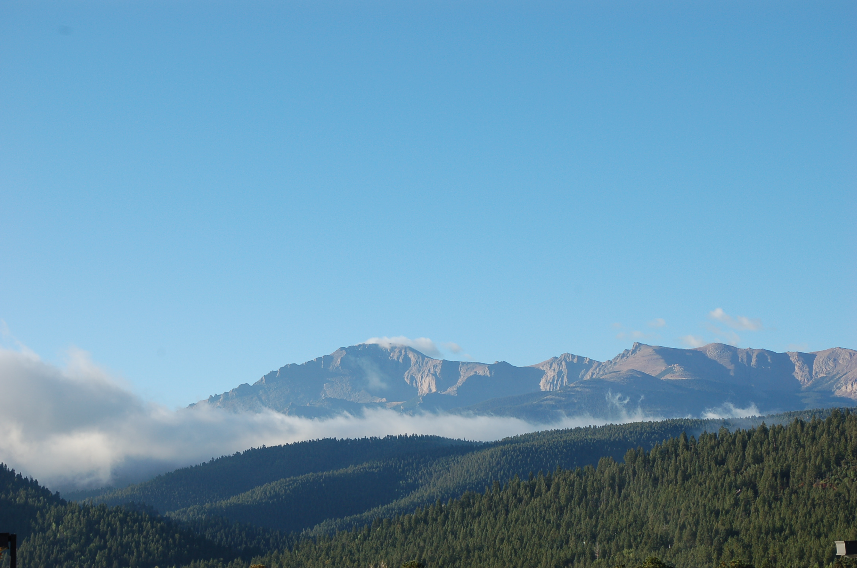
Major Achievements
State of our County
is strong and thriving

Slide 11
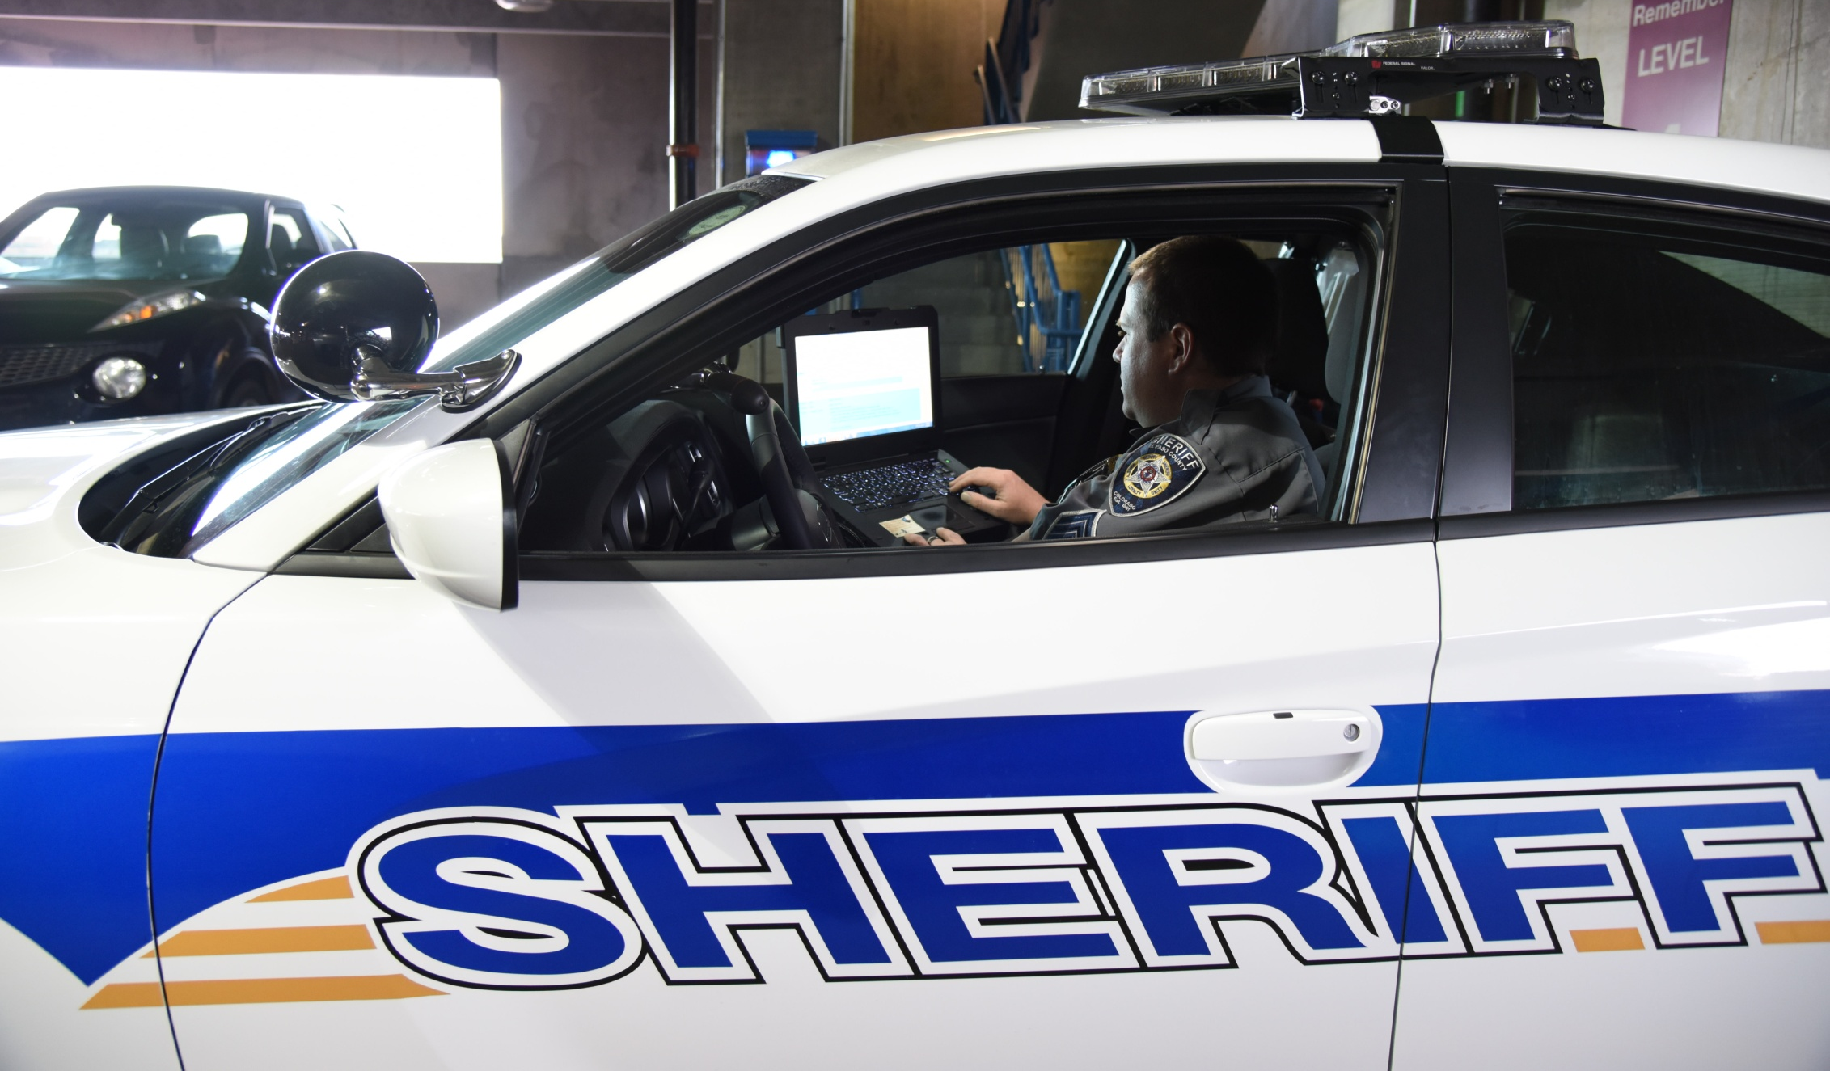
Major Achievements
Public Safety Sales Tax Extension:
71% of the vote

Slide 12
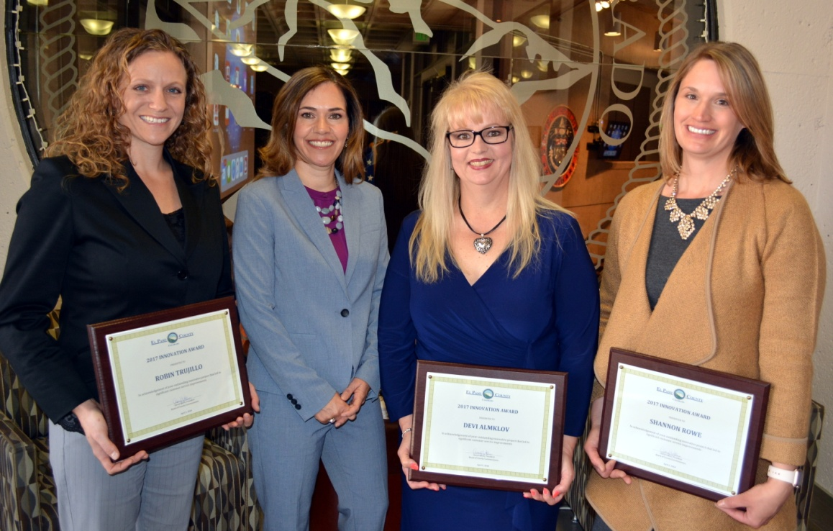
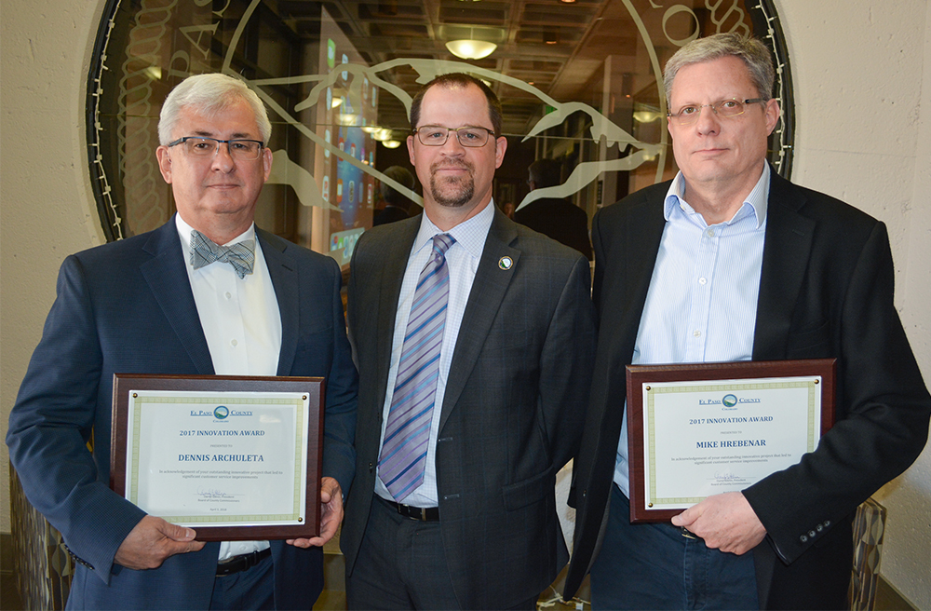
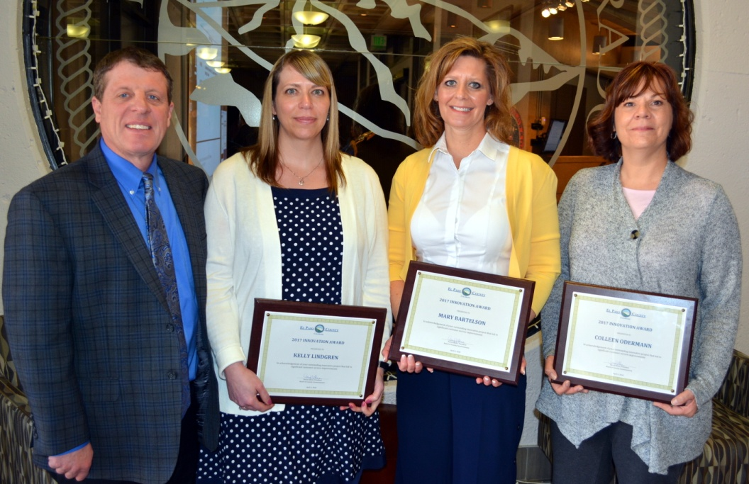
Award Winning County
Steve Schleiker & Office of the County Assessor-Downtown Star Award
Finance Division-Excellence in Financial Reporting for the 2017 Comprehensive Annual Financial Report (CAFR), published in 2018
Budget Division-Distinguished Budget Presentation Award for the 2018 Budget Book
El Paso County Parks-Land Management Partner of the Year
El Paso County & Fort Carson-2018 Army Community Partnership Award
Traci Marques-2018 Women of Influence
Karen Logan-DHS Field Instructor of the Year
DHS-Extending Goodwill Award
Chris Gavin-Pat Lysinger Memorial Volunteer of the Year
DHS-NACO Achievement Award
Community Development-NACO Achievement Award for EDARP
Zach Knight-2018 Outstanding Public Works Employee

Slide 13
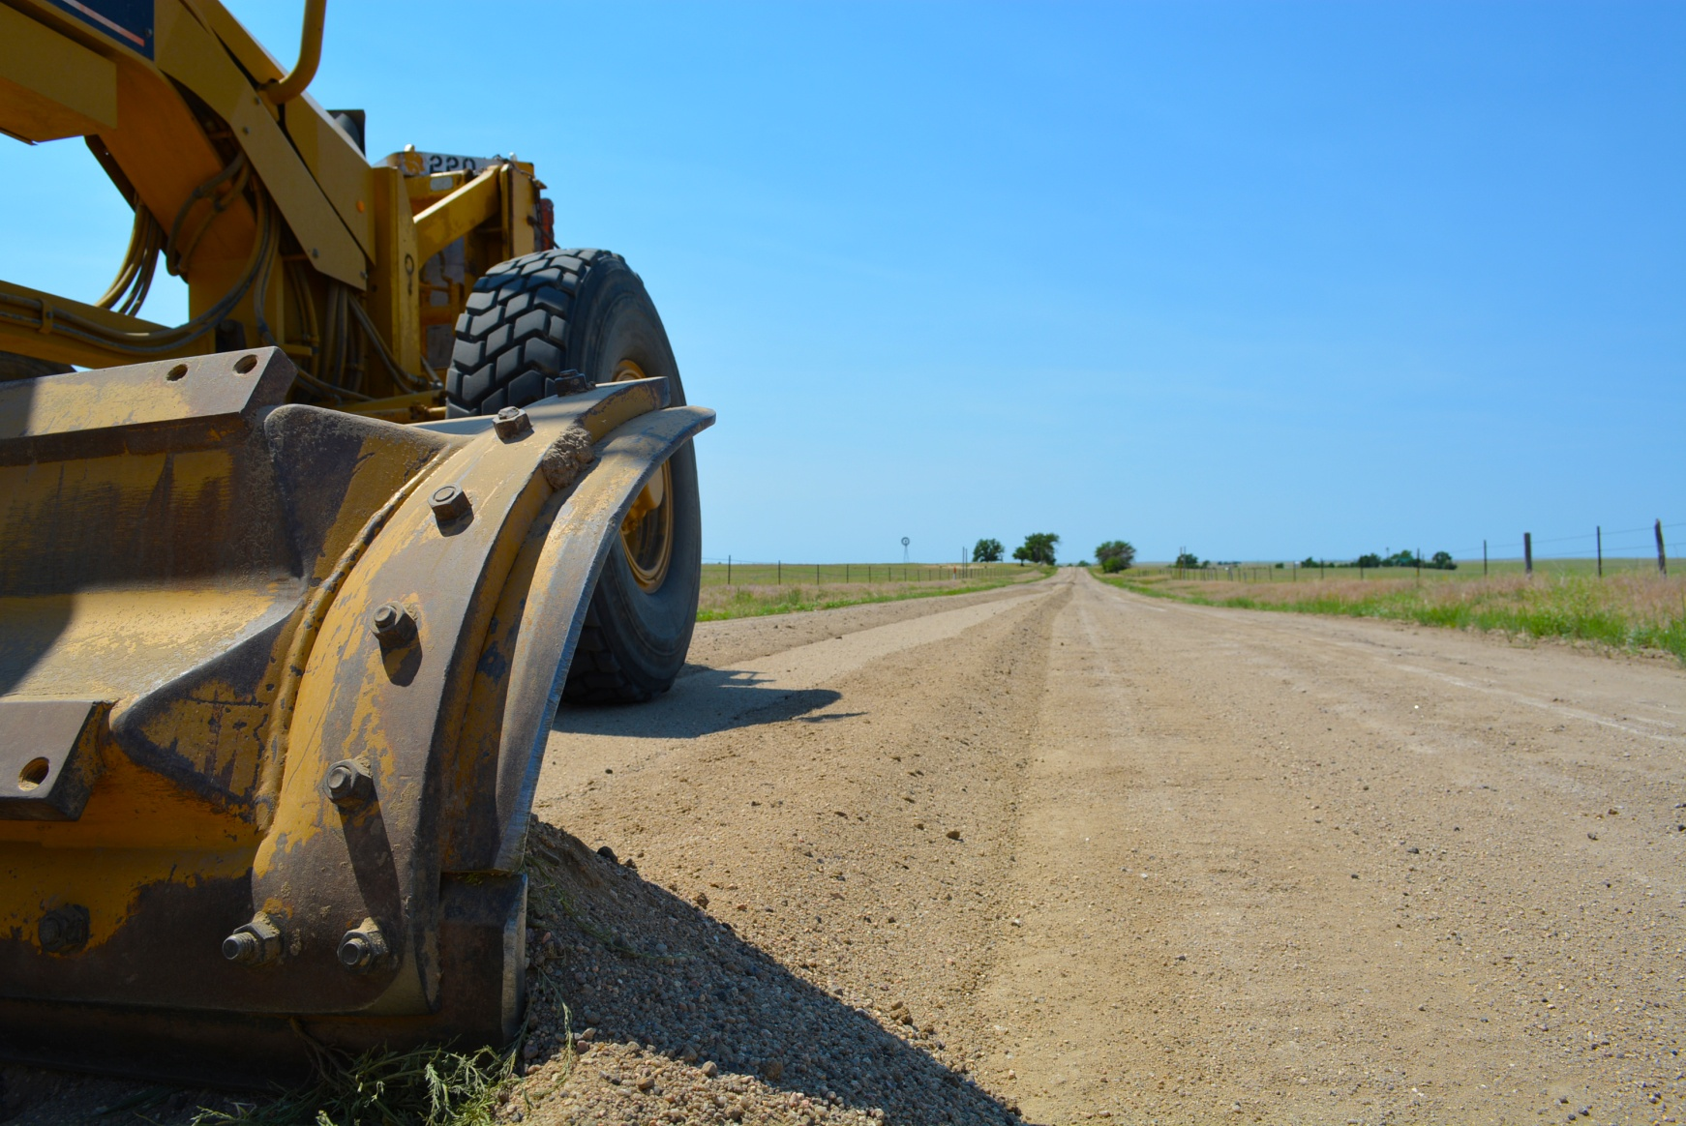
Public Works
2,177 Road Miles
1,127 Miles Paved
1,050 Miles Gravel
273 Bridges
40 County-wide construction projects in 2018
51 Miles of Chip Seal
76 Miles of Dust Abatement
23.5 Miles of Overlay
Re-capitalization
Graders, Plows, Vehicles, Salt Trucks
Truck Wash

Slide 14
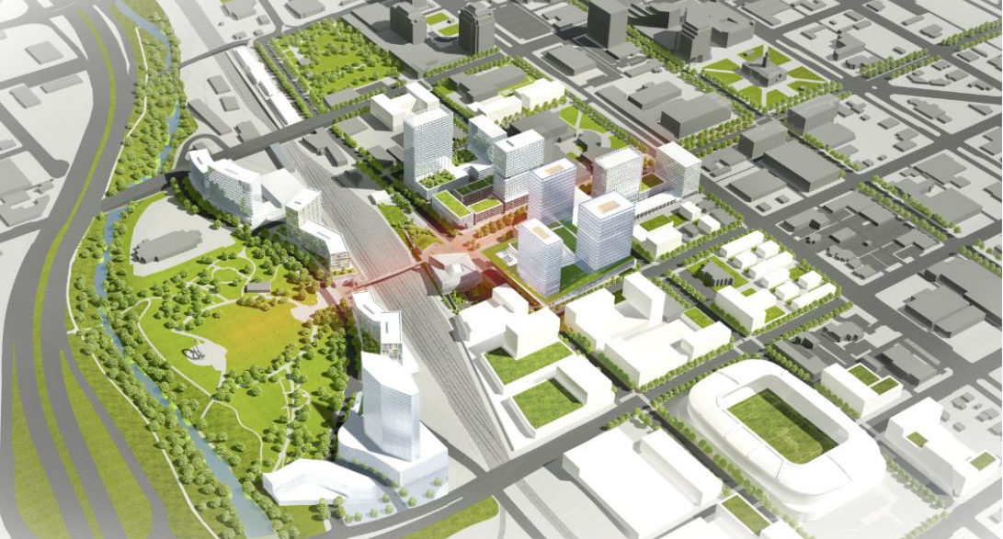
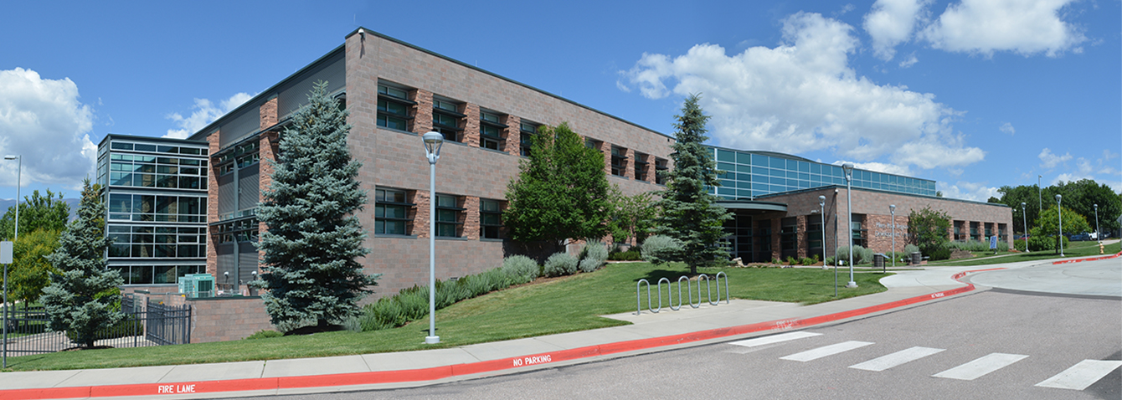
Colorado Springs Urban Renewal
Major Development Projects
Over 1,500 new single family home permits in 2018
Notes:
Urban Renewal – 4,500 apartments downtown over next 20 years
Continued approvals for single family home development
Critical to address median housing costs so our cost of living doesn’t skyrocket

Slide 15
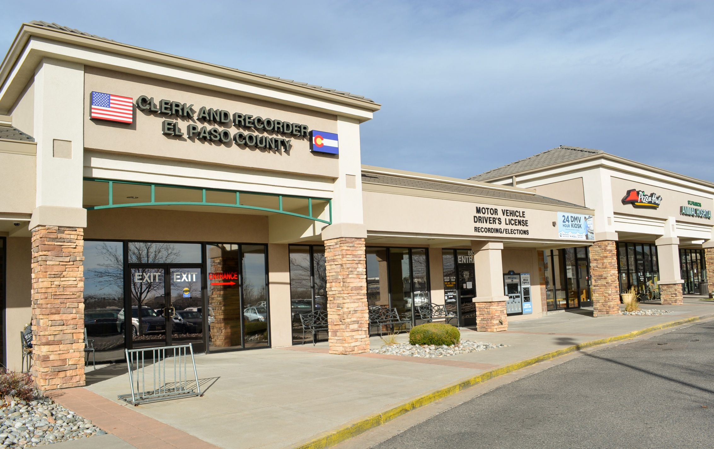
County Clerk & Recorder
875,000 Motor Vehicle Transactions
108,000 Driver’s License Transactions
158,000 Recorded Documents
6,400 Marriage License Applications
283,277 Election Ballots Counted in November 2018, a new record.

Slide 16
Veteran Services
98,000 Veterans in El Paso County
More than 2,000 Benefit Claims Assisted Annually
8,500+ Client Visits Annually
$591 Million in VA Benefits Received in 2016 by El Paso County Veterans and Families

Slide 17
Human Services
$3.8 Million In Savings
15,812 reports of Child Abuse and Neglect
3,115 reports of Elder Abuse or Neglect
$8.2 million (average) in Food Assistance each month
522 adoptions for children living in foster/kin care in the last 5 years

Slide 18
County Parks
13 Parks with 8,000 Total Acres
120 Miles of Trails
6 Recreational Areas
2 Nature Centers
1 Fair and Events Center
1,000 Rec. and Ed. Programs
Tri-Lakes Area
Elephant Rock Open Space
Fox Run Regional Park
Santa Fe Trail
Notes:
Elephant Rock – Land has been aquired. 60 acres, near Palmer Lake, When opened will feature a multi-user stacked loop trail system accessible from the Palmer Lake Rec Area and the New Santa Fe Trail.
Fox Run Regional Park – 417 acres, playgrounds, lakes, dog parks, wedding gazebo
Santa Fe Trail – 14 mile trail from Town of Palmer Lake to downtown Colorado Springs.

Slide 19
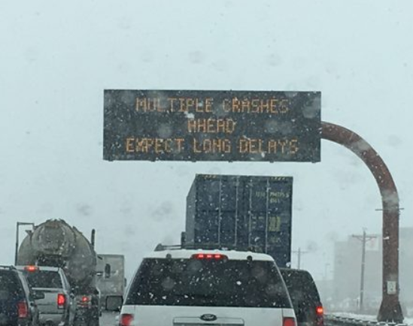
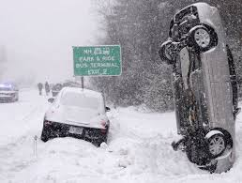
Sunny Songs #1:
What song does Annie sing about sun in the Broadway musical Annie?
Website: www.ElPasoCo.com
App:
EPCCitizenConnect

Slide 20
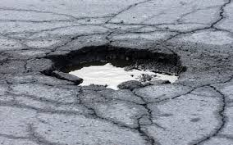
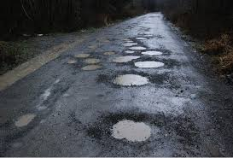
Sunny Songs #2:
What song did the Beatles sing about the sun?
Website: www.ElPasoCo.com
App:
EPCCitizenConnect

Slide 21
Sunny songs #3:
What song did John Denver sing about sunshine?
Text I25 to
21000
For alerts

Slide 22
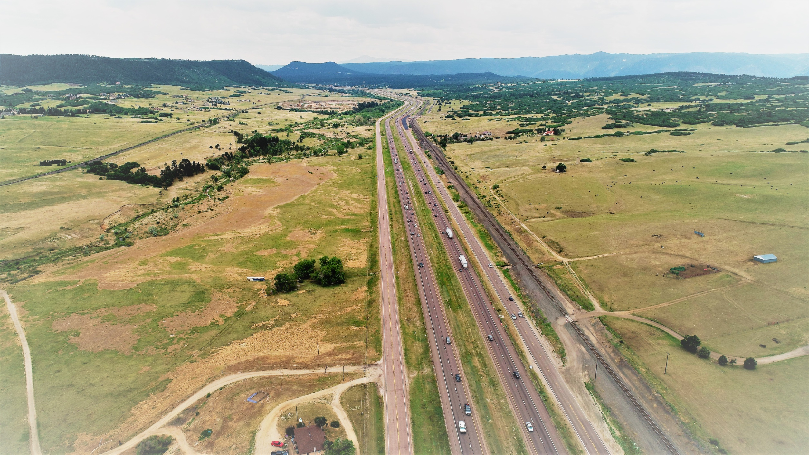
I-25 Widening – The GAP
Construction has Started!
$65M Federal Infra Grant Secured

Slide 23
Sunny songs #4:
Who sings about having sunshine in his pocket?
Annual cost per citizen $271
Website: www.ElPasoCo.com
App:
EPCCitizenConnect
Current projects:
Monument Hill Road
Highway 105
Struthers/Gleneagle

Slide 24
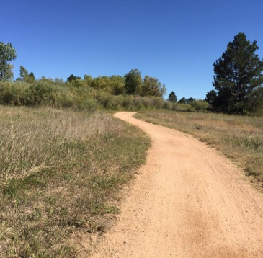
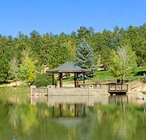
Sunny Songs #5:
Who sings “I’m walking on sunshine. . .”
(three different choices)
Website: www.ElPasoCo.com
App:
EPCCitizenConnect

Slide 25
How You Can Help
El Paso County has more than
40 Volunteer boards and commissions.
Get involved at:
www.ElPasoCo.com

Slide 26
Engage with El Paso County
facebook.com/ElPasoCountyCO
youtube.com/user/ElPasoCountyCO
twitter.com/EPCpio
www.ElPasoCo.com

Slide 27
Questions?
Holly Williams
El Paso County Commissioner
District 1
Office: 520-6411
E-mail: hollywilliams@elpasoco.com
Stan VanderWerf
El Paso County Commissioner
District 3
Office: 520-6413
E-mail: stanvanderwerf@elpasoco.com
Centennial Hall
200 South Cascade
Colorado Springs, CO 80903
Website: www.ElPasoCo.com
App:
EPCCitizenConnect

